Slide 1

Image Guided Surgery
Team 1 : Orthopaedic Surgery

Slide 2
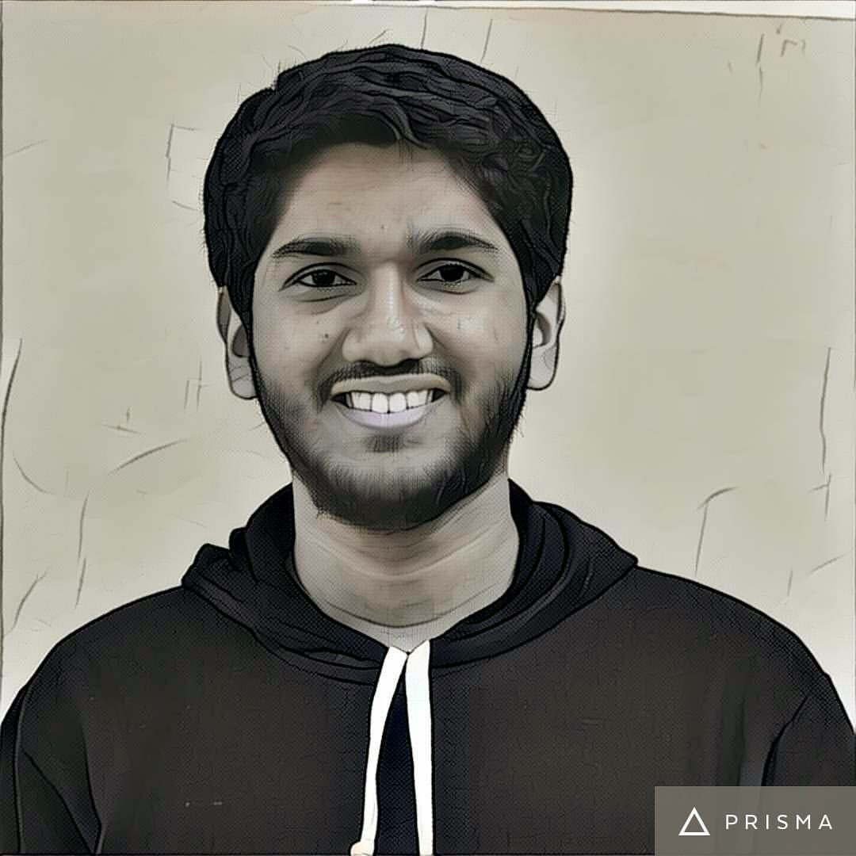
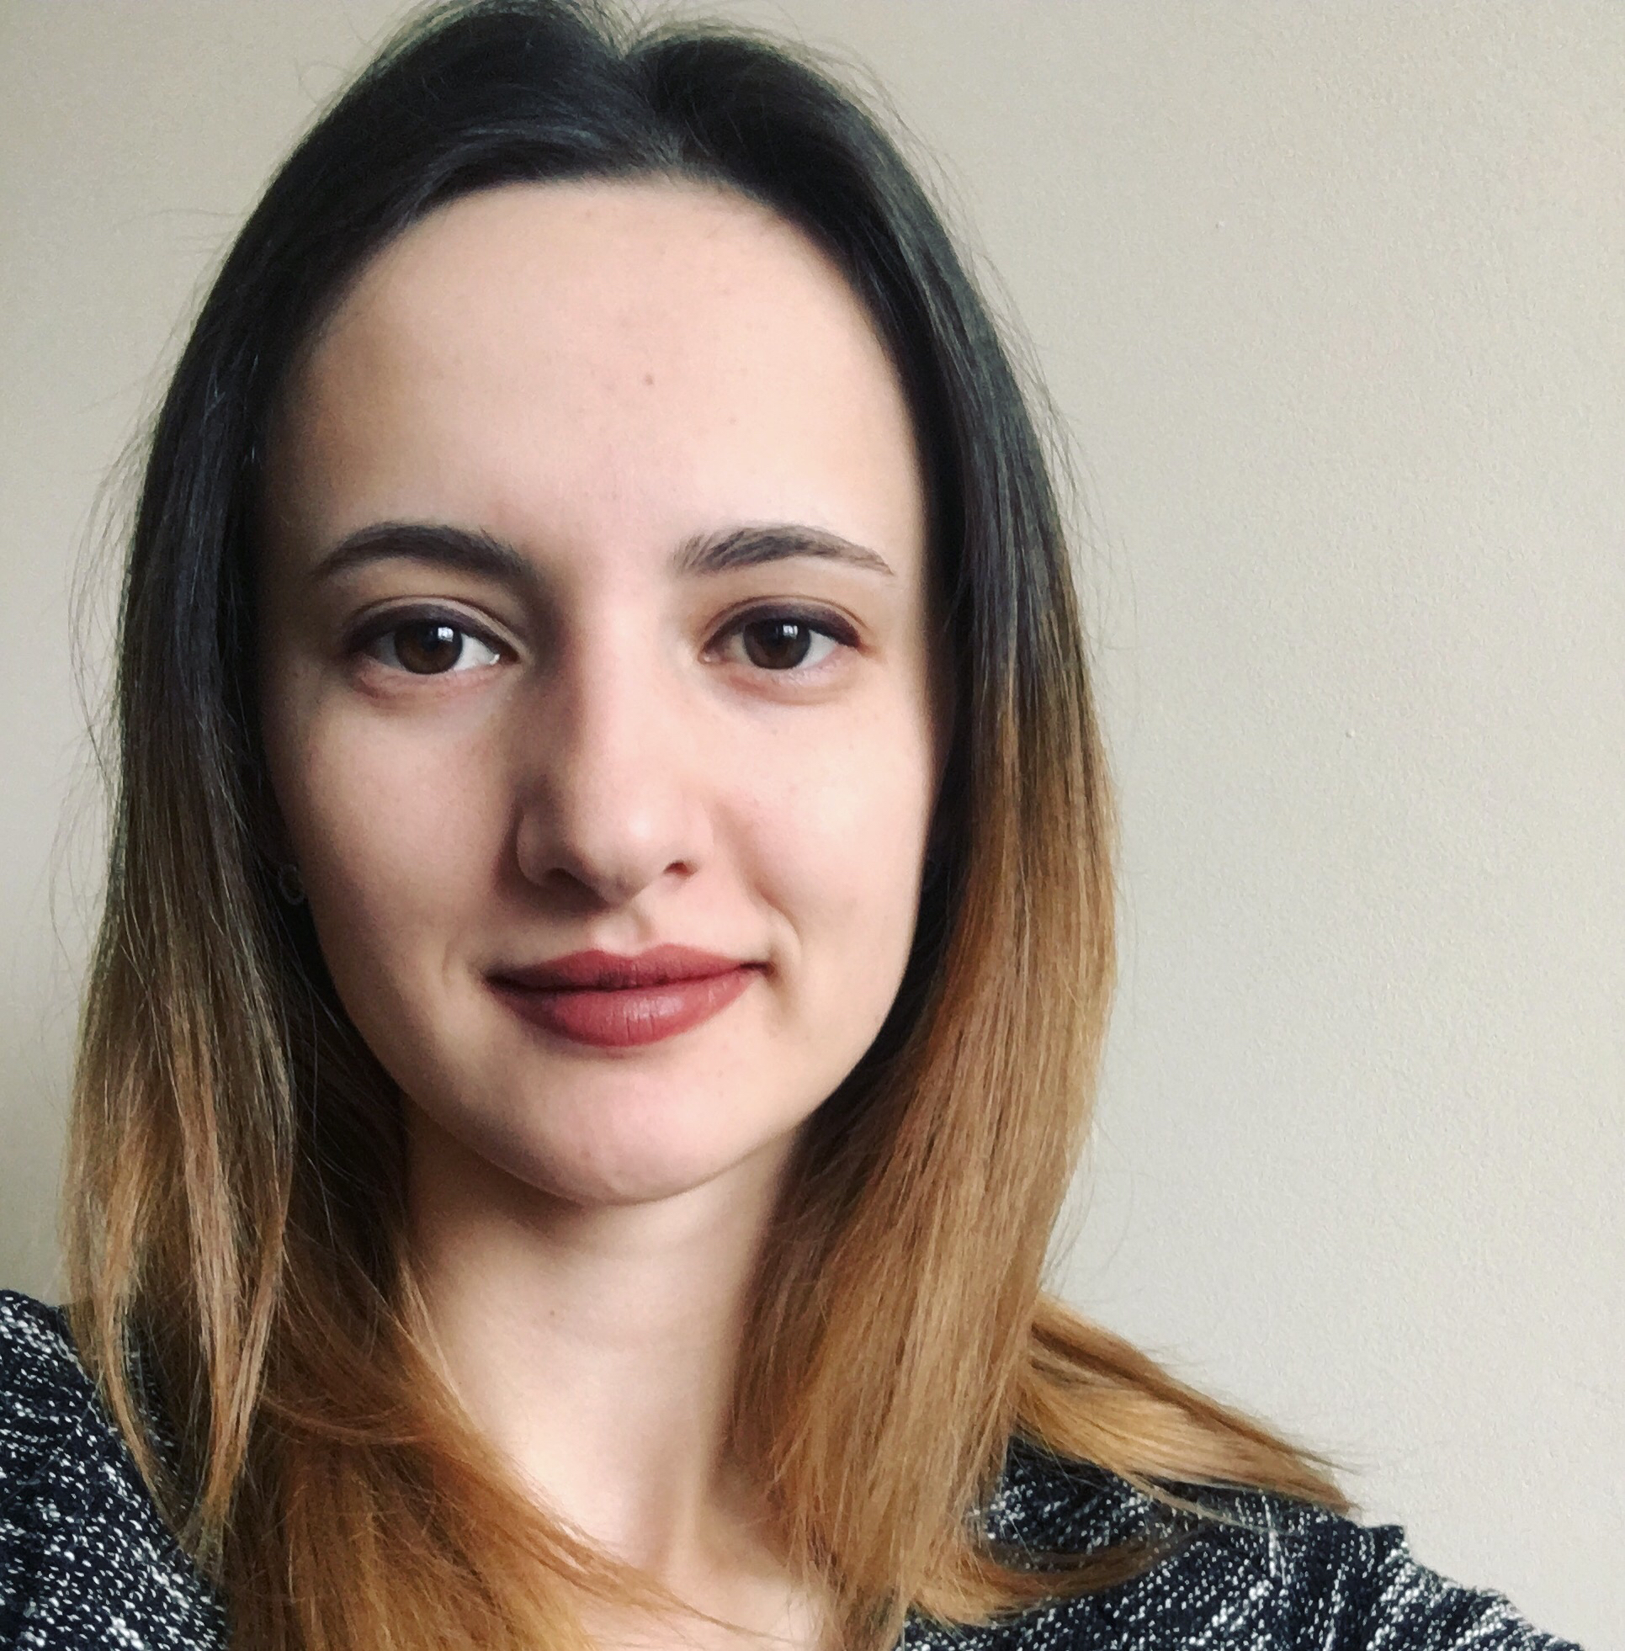
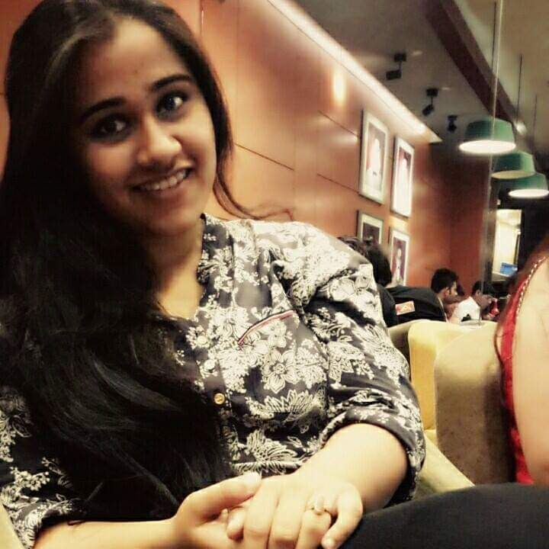

Hello, World!
Wasiq Rumaney
M.Sc Informatics
Diana David
M.Sc Biomedical Computing
Vindhya Singh
M.Sc Informatics
Md Rakibul Alam
M.Sc Informatics

Slide 3
What we are gonna talk about...
Orthopaedics Domain: Facts and Figures, Statistics
Major tasks of an Orthopaedic Surgeon
Major procedures
Available IGS solutions (Commercial)
Available IGS Solutions (Research)
State-of-the-Art Research
Problem Areas
Future Research Areas
Summary

Slide 4
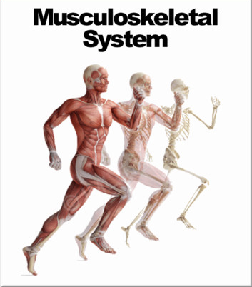
Orthopaedics Domain
A medical specialty that focuses on the
diagnosis
correction
prevention
treatment
….of
Musculoskeletal System
bones, joints, muscles, ligaments, tendons, nerves and skin

Slide 5
Orthopaedics: Quick facts and figures*
Average age of practising orthopaedists: 55.24 years
Most frequently cited areas
Sports medicine
Total joints
Hands
Orthopaedists perform average of 30 procedures per month
*https://www.aaos.org/uploadedFiles/PreProduction/Research/Research_Tools/orthocensus/2016%20Census%20Final%20-%20Public%20Quick%20Facts.pdf. Accessed 08 Nov 2018.

Slide 6
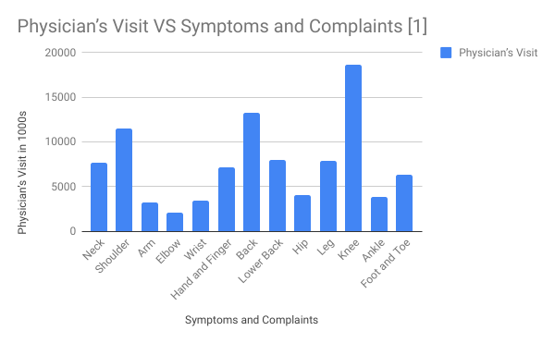
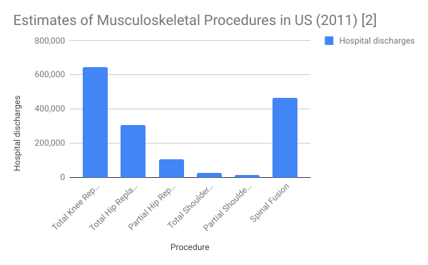
Orthopaedics: Interesting Statistics
Department of Research & Scientific Affairs, American Academy of Orthopaedic Surgeons. Physician Visits for Musculoskeletal Symptoms and Complaints. http://www.aaos.org/research/stats/patientstats.asp . Updated November 2013. Accessed 08 Nov 2018.
Department of Research & Scientific Affairs, American Academy of Orthopaedic Surgeons. Annual Incidence of Common Musculoskeletal Procedures and Treatment. http://www.aaos.org/research/stats/CommonProceduresTreatments-March2014.pdf . Published March 2014. Accessed 08 Nov 2018.

Slide 7
Major tasks of an Orthopaedic surgeon
DIAGNOSIS
TREATMENT
REHABILITATION
PREVENTION
Arthrography
Blood tests
CT scan
Discography
Doppler ultrasound
Flexibility tests
Muscle tests
MRI
X-rays
Palpation
Venography
Medication
supplements to strengthen joints or minimize pain
Exercise
Casting and splinting
Surgery
Exercise
Physical therapy
to restore movement, strength and function
Exercise
Balanced diet
Healthful weight

Slide 8
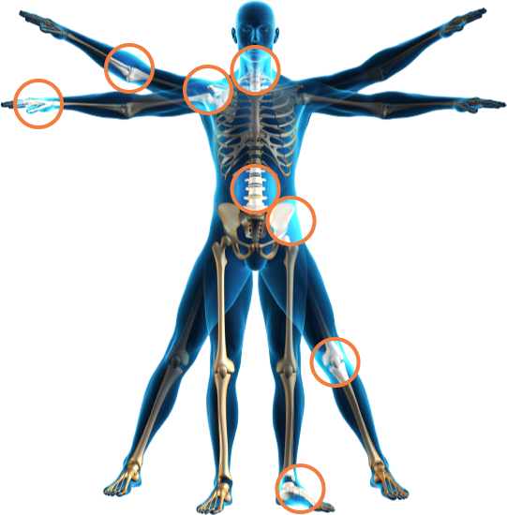
Major procedures
Arthroscopy
Spine fusion
Joint replacement
Fusion of bones
Debridement

Slide 9
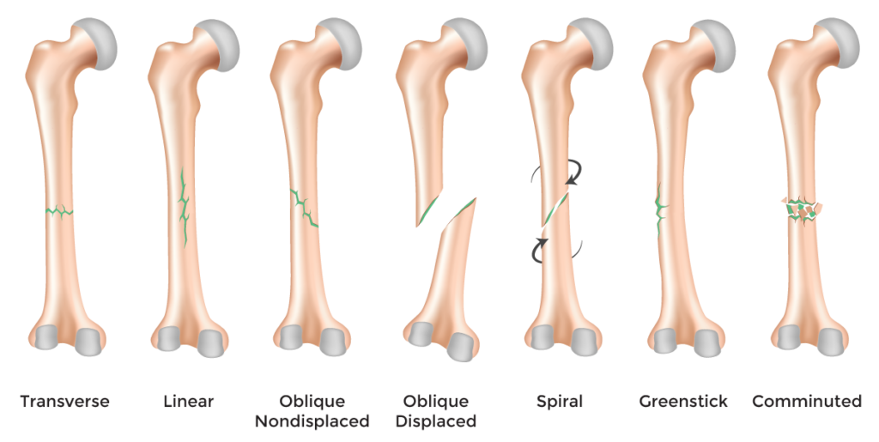
Major procedures - bone fracture repair

Slide 10
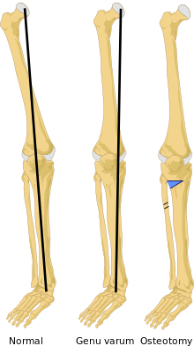
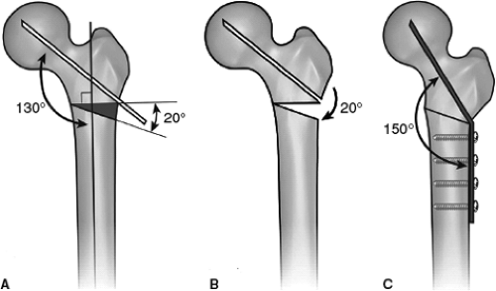
Major procedures
- Osteotomy

Slide 11
Available IGS solutions (Commercial)
Computed Tomography (CT) scanners
Ultrasound Systems
Magnetic Resonance Imaging (MRI)
X-ray Fluoroscopy
Positron Emission Tomography (PET)
Single Photon Emission Computed Tomography (SPECT)

Slide 12
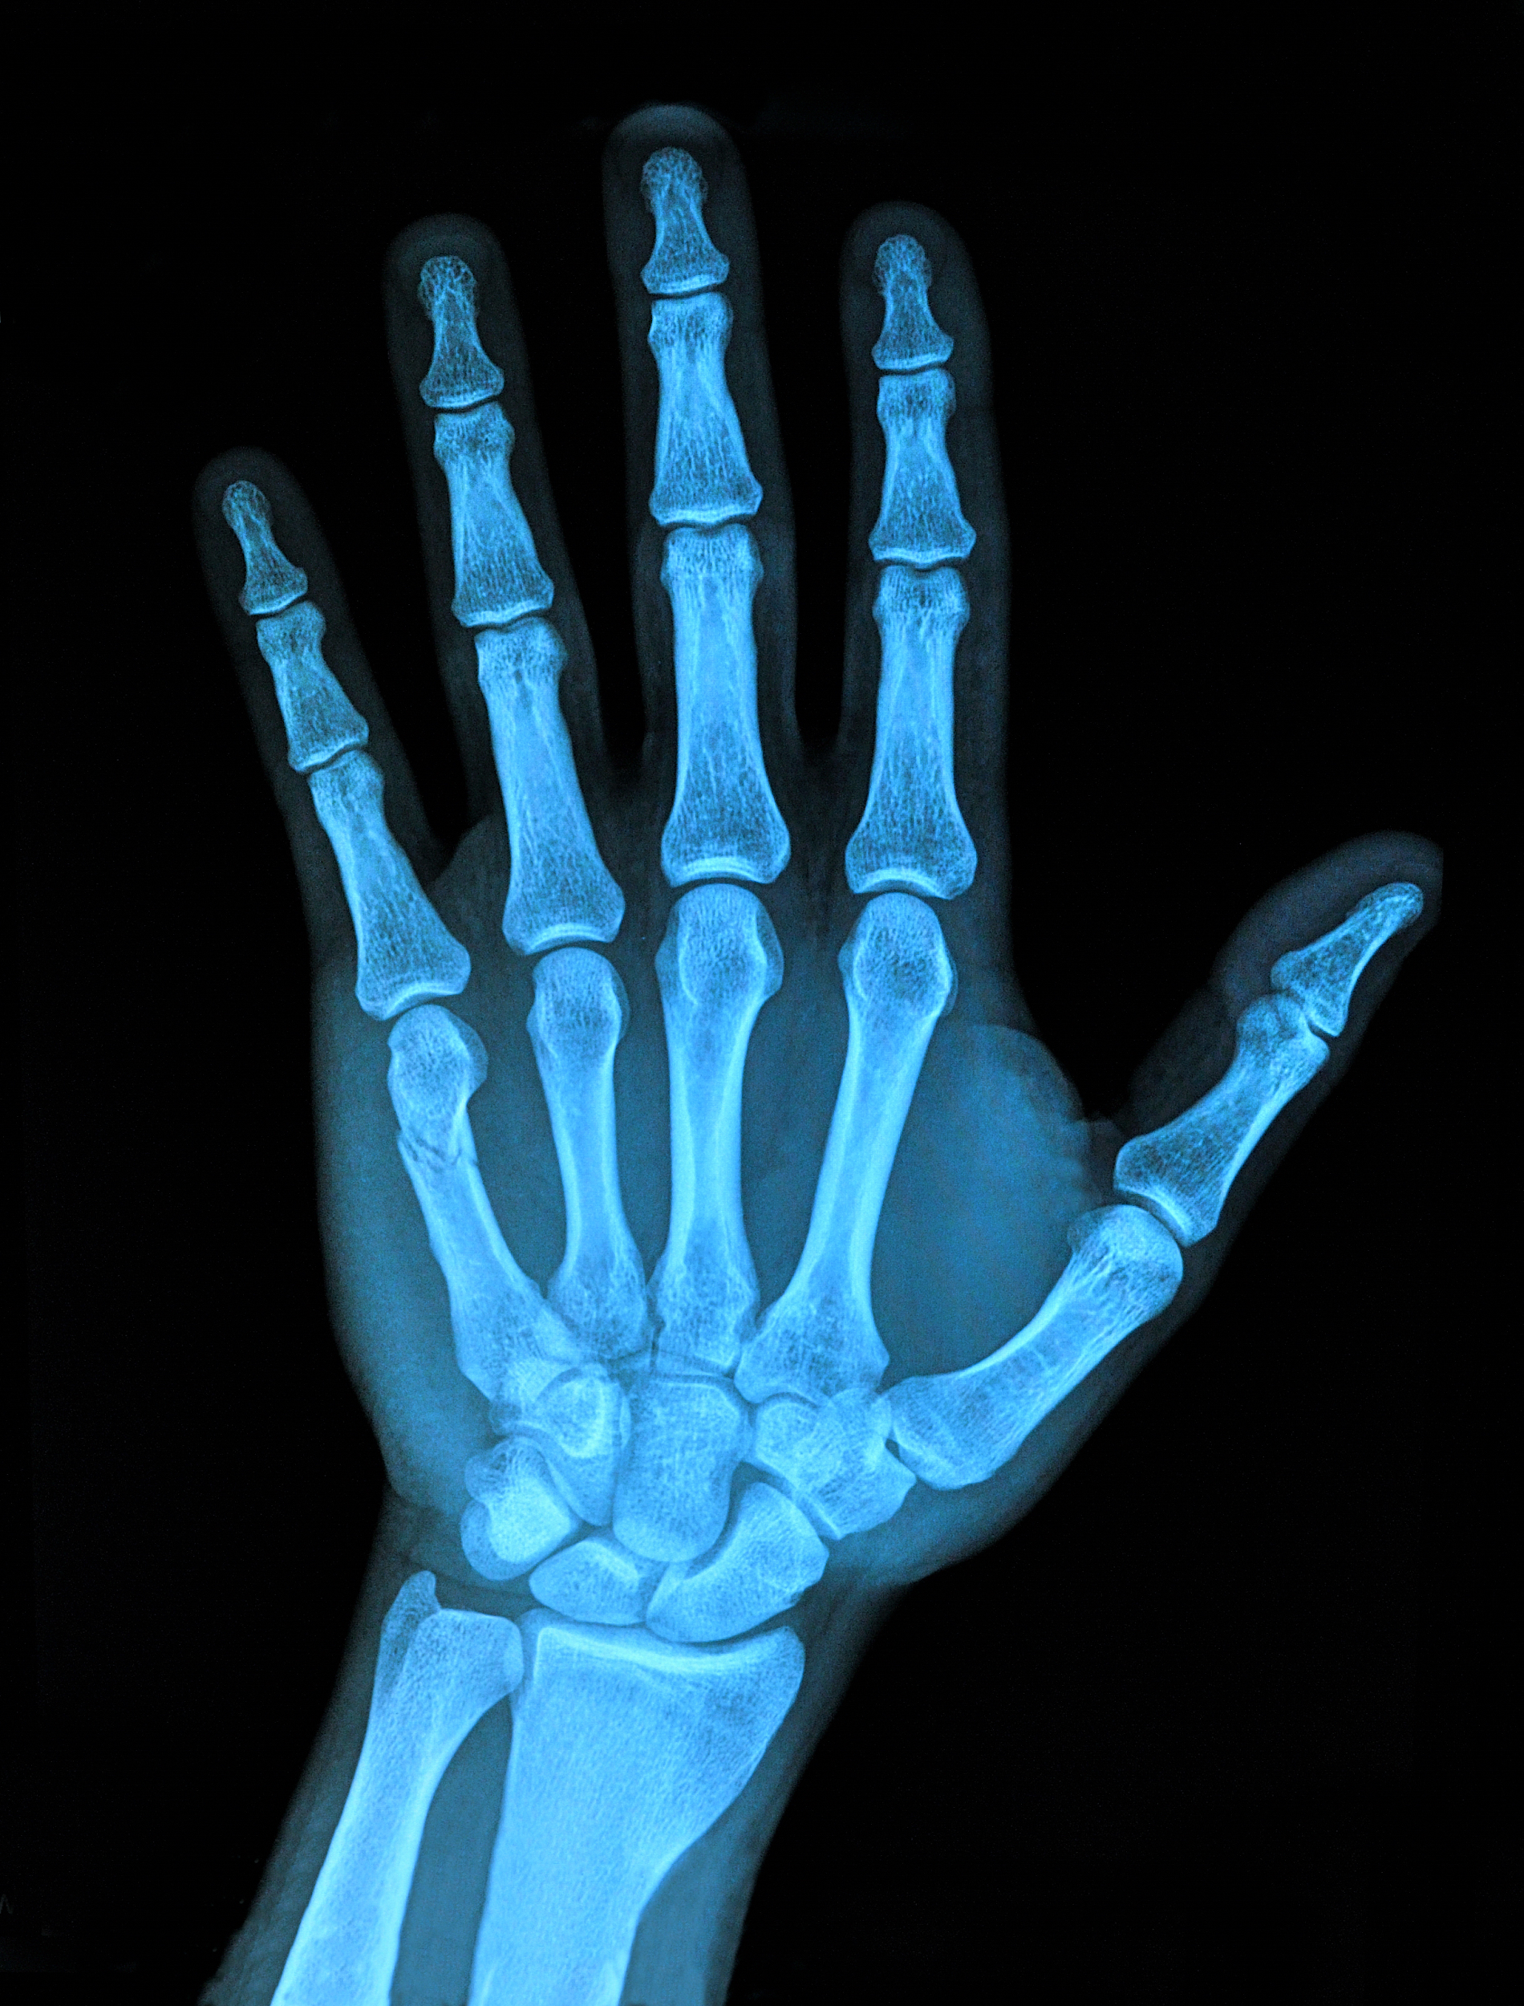
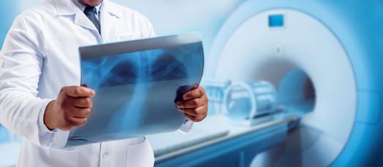
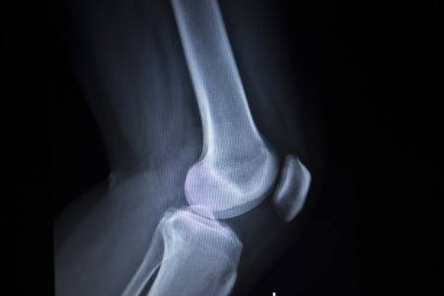
Computed Tomography (CT) scanners
Texas Orthopedics, Sports and Rehabilitation Centre
Source: https://orthocentre.co.nz/
X-ray orthopedic medical CAT scan of painful knee meniscus injury leg in traumatology hospital clinic

Slide 13
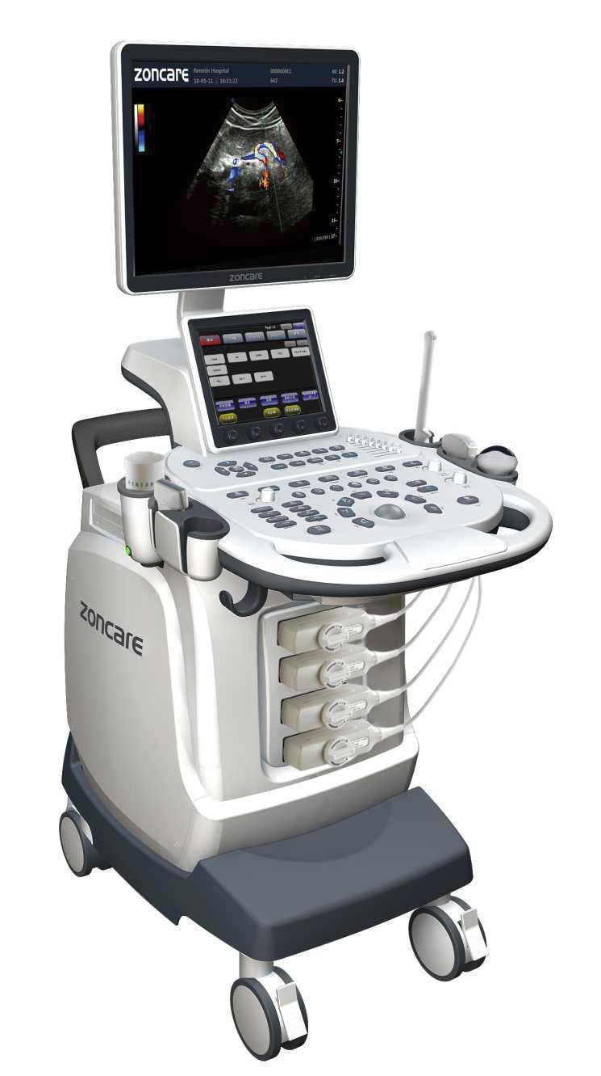
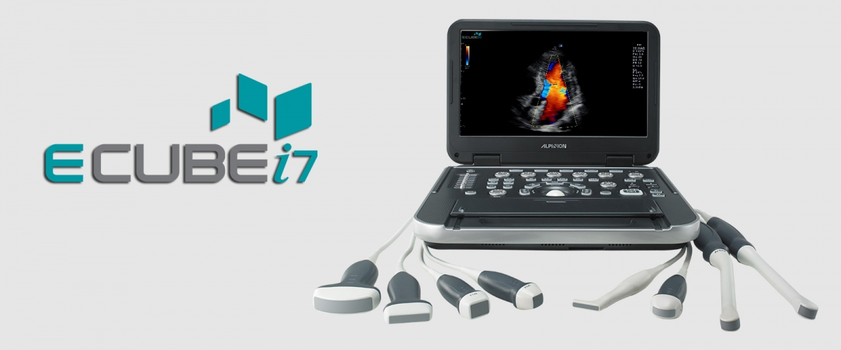
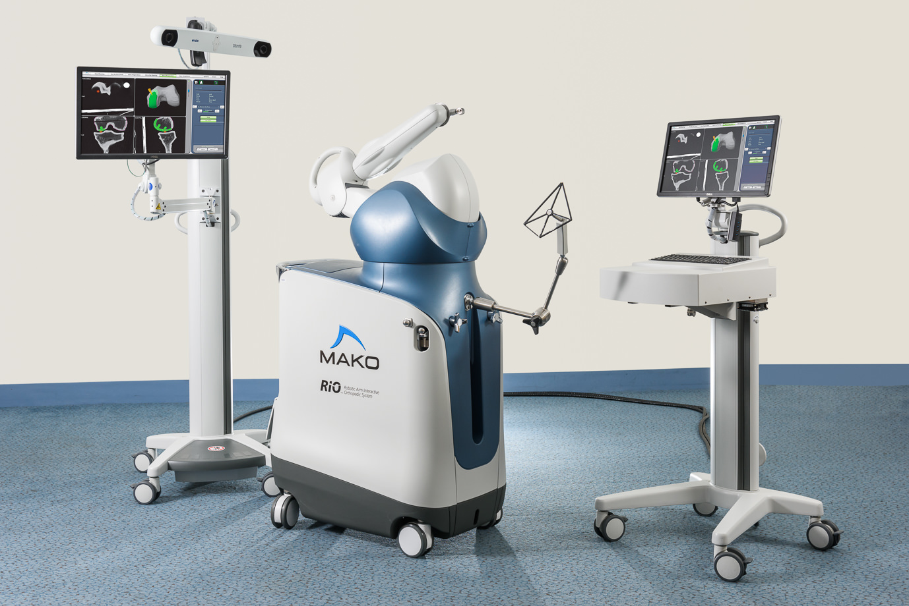
Ultrasound Systems

Slide 14
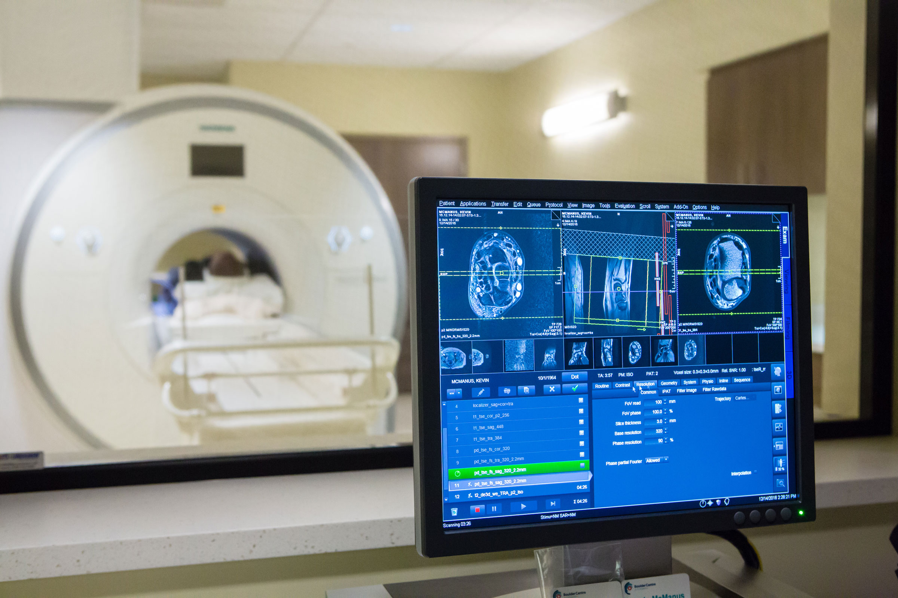
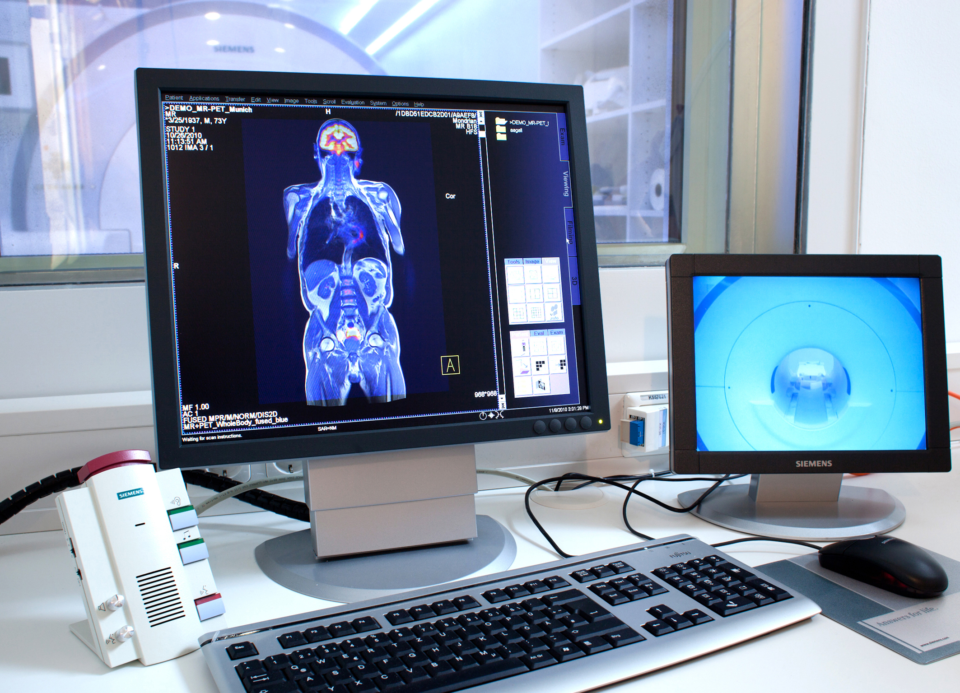
Magnetic Resonance Imaging (MRI)
Siemens Biograph mMR hybrid system
Siemens Skyra 3T MRI Scanner

Slide 15
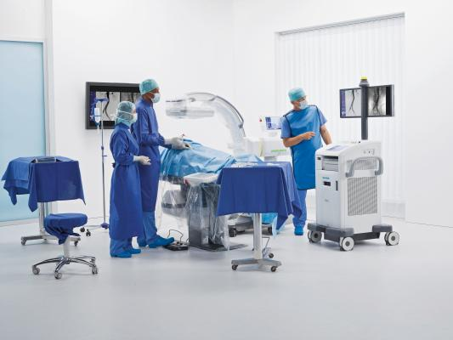
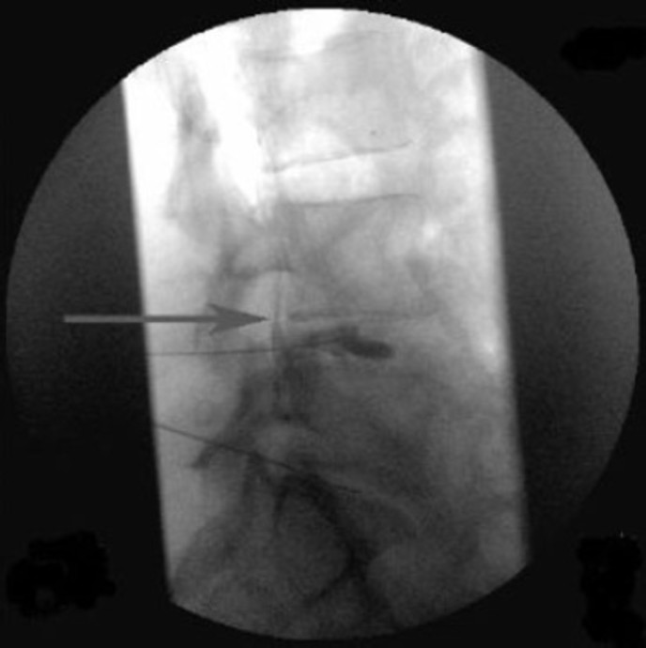
X-ray Fluoroscopy
https://www.cfaortho.com/patient-services/imaging/fluoroscopic-injections
Siemens' Cios mobile C-arm system.

Slide 16
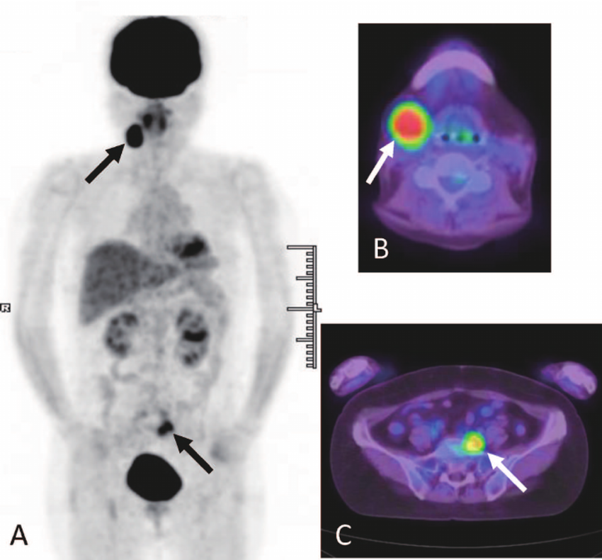
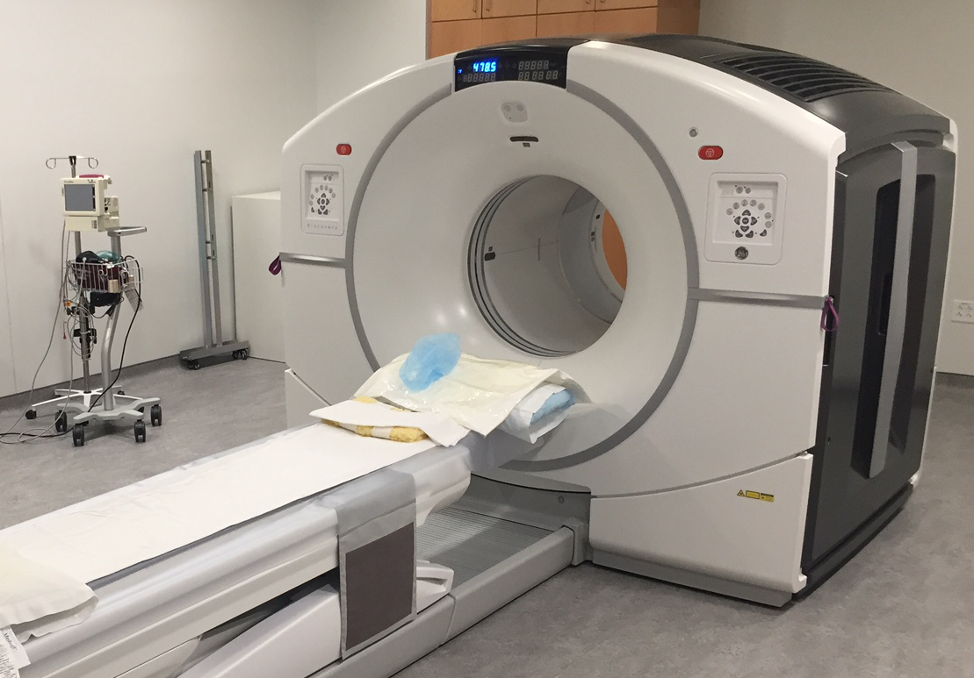
Positron Emission Tomography (PET)
Positron Emission Tomography Facility, The Iowa Institute for Biomedical Imaging
Tanaka, Kae & Harada, Hiroyuki & Kayamori, Kou & Omura, Ken. (2015). Chronic Sclerosing Sialadenitis of the Submandibular Gland as the Initial Symptom of IgG4-Related Disease: A Case Report. The Tohoku journal of experimental medicine. 236. 193-8. 10.1620/tjem.236.193.

Slide 17
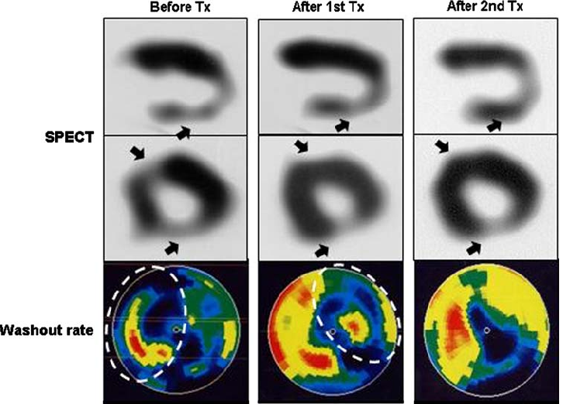
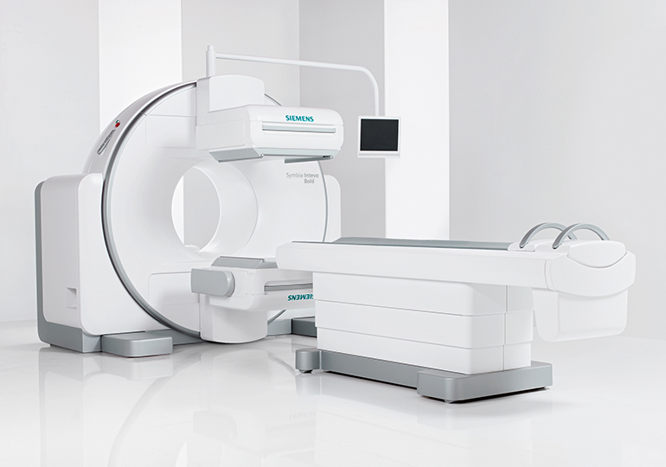
Single Photon Emission Computed Tomography (SPECT)
Siemens Symbia Intevo Bold SPECT/CT
Shimokawa, Hiroaki & Ito, Kenta & Fukumoto, Yoshihiro & Yasuda, Satoshi. (2008). Extracorporeal cardiac shock wave therapy for ischemic heart disease. Shock Waves. 17. 449-455. 10.1007/s00193-008-0122-5.

Slide 18
Available IGS Solutions (Research)
Evolved around two decades ago.
(CAOS) module : real-time feedback through a virtual scene of the situs presented on a display device, employment of surgical robots.
Components Involved:
A therapeutic object [(TO), target of the treatment]
A virtual object [(VO), virtual representation in the planning and navigation computer]
Navigator [links both objects]

Slide 19
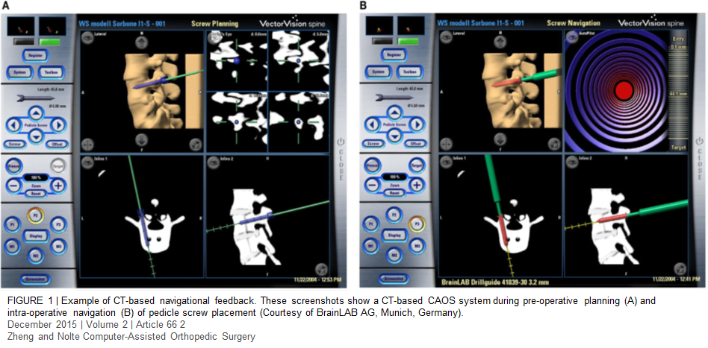
There are 3 methods of navigation used to carry out the surgery
CT-Based: utilizes CT imaging to construct a 3-D* model of the patient's anatomy to guide the surgeon

Slide 20
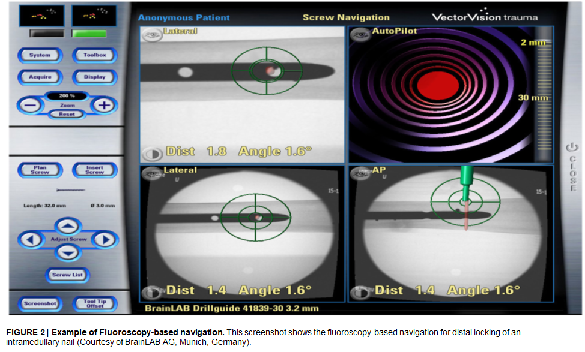
Fluoroscopy-Based: allows the surgeon to take multiple fluoroscopic images (at different angles) of the surgical site

Slide 21
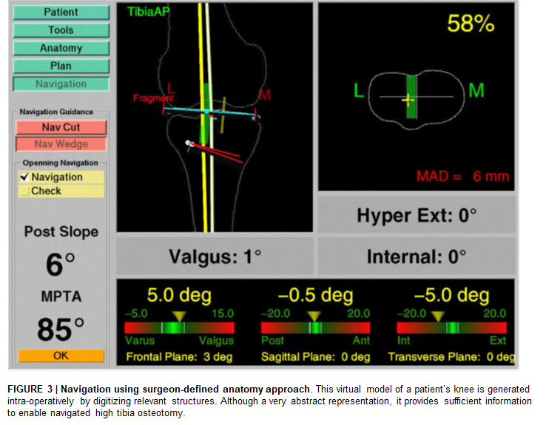
Imageless: computer constructing a digitized anatomical model of the area of interest by using results of the patient’s orthopedic tests

Slide 22
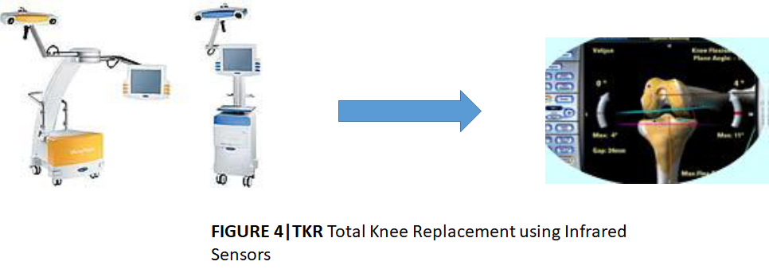
State-of-the-Art Research
Notes:
Repeatability
3d Bone modelling disadvantages

Slide 23
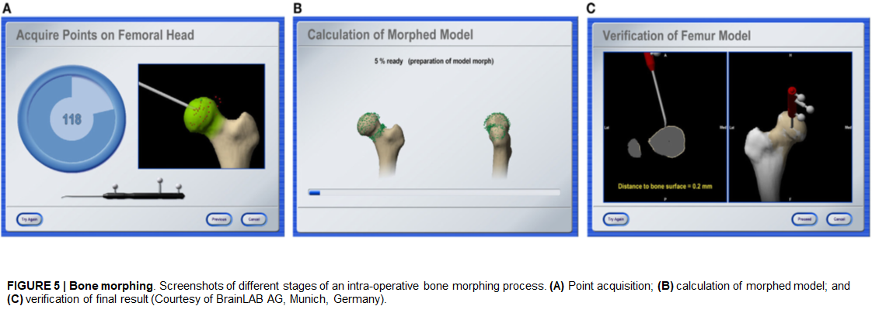

Slide 24
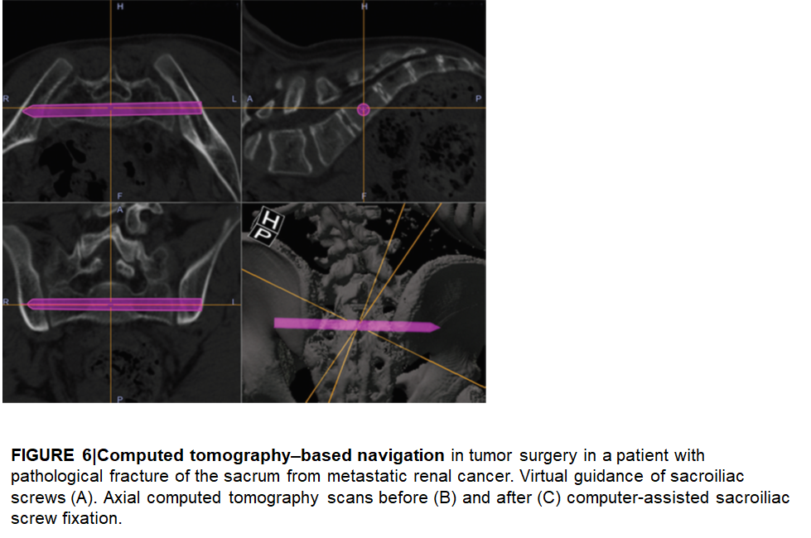
Notes:
Computer-assisted navigation
has also been used
to improve the accuracy of
the insertion of bone anchors
on the glenoid rim for
the repair of anterior labral
tears.87,88 The anchor has to
be inserted on the glenoid
rim at just the right angle
to achieve maximal bone
support and increase the
pullout force.87 Improper
insertion predisposes to
failure of the reconstruction
and possibly damage
of the articular cartilage.
Computer-assisted navigation
offers a multiplanar
visualization throughout
the procedure, resulting in
a more accurate placement
of the bone anchors.

Slide 25
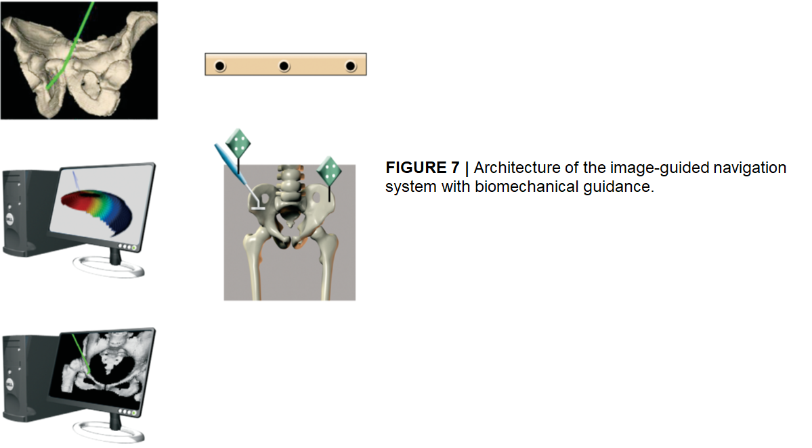
Optotrack camera
Tracking
and
referencing
Infrared Markers
Preoperative
planning
Near-real-time
analysis

Slide 26
Problem Areas
Operating in Real-time
Superficial infection at the sites of probes insertion
Potential increased surgical time required to perform the procedure
Medical costs to the patient
Each of the navigation methods has a shortcoming:
CT-based navigation systems increase radiation exposure
Fluoroscopy-based navigation increases the duration of the procedure as the surgeon needs to pause and take images of proper templates
Imageless navigation relies heavily upon the skill of the surgeon to input data from test results

Slide 27
Future Research Areas
To test the protocol for computer-assisted osteotomy with online biomechanical guidance and to study the reliability of the results when using the BGS.
To improve the accuracy and better real time and postoperative imaging .
Improving the accuracy of prosthetic implantation and at furthering efforts at minimizing the surgical exposure in TKR.
Hybrid CAOS systems are under development
New generations of mobile-imaging system.

Slide 28
Summary
Image Guided Surgery plays a pivotal role in Orthopaedics.
The history of IGS in Orthopaedic Surgery is fairly new.
Improves the accuracy and precision of various Orthopaedic Surgeries.
However, the long term operative outcomes have still not been analysed.
Room for improvement remains in the functionalities and aligning the innovation with the real world in real time.

Slide 29

Any Questions?

